Slide 1

TWITTER MINING USING R
YASEEN AHMED SHAIK (2668256)
SAIYAM KOHLI (2669077)

Slide 2
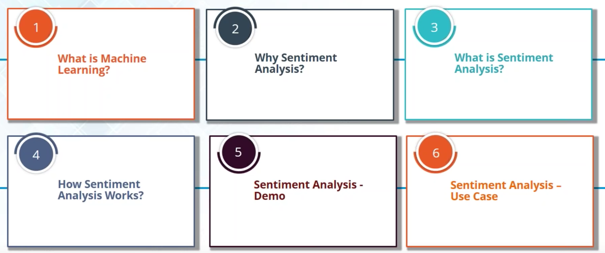
Introduction

Slide 3

What is Machine Learning?
Machine learning is a type of artificial intelligence (AI) that provides computers with the ability to learn without being explicitly programmed.

Slide 4
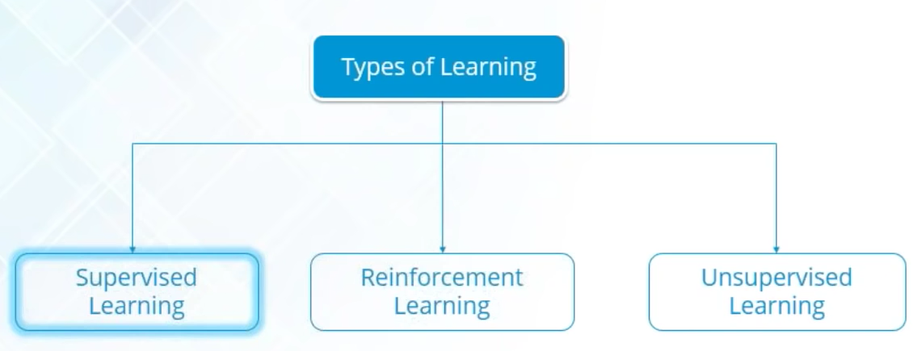
What is Machine Learning?
Type of machine learning:

Slide 5
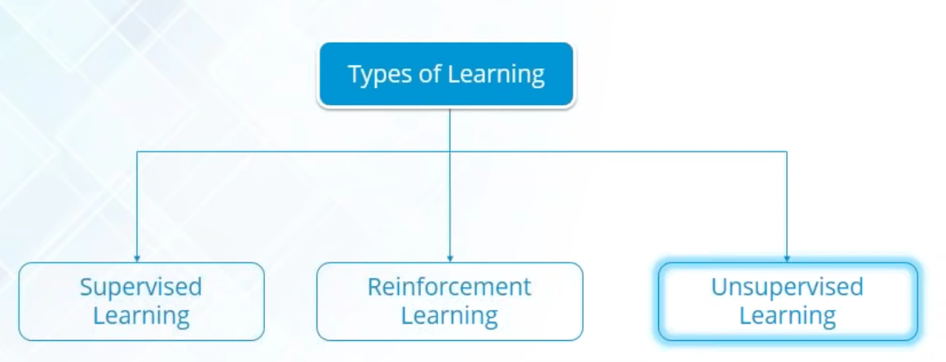
What is Machine Learning?
Type of machine learning:

Slide 6
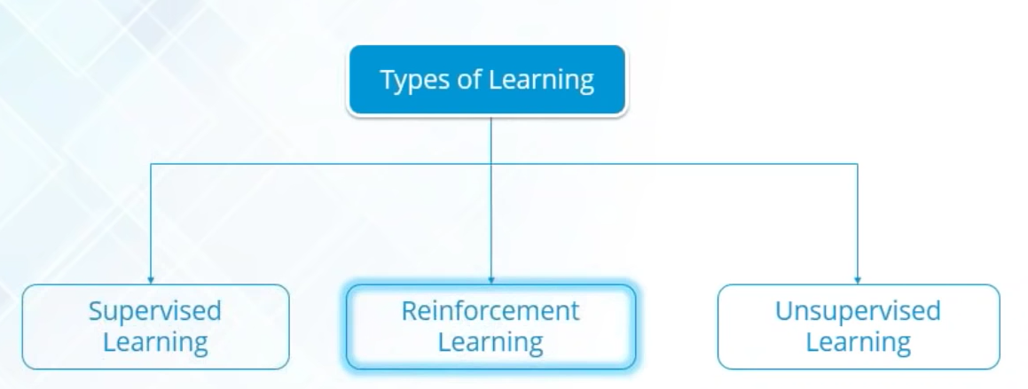
What is Machine Learning?
Type of machine learning:

Slide 7
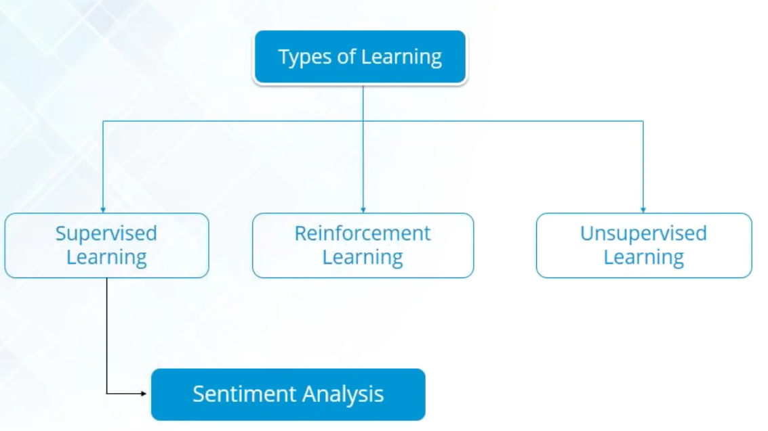
What is Machine Learning?
Type of machine learning:

Slide 8

Why Sentimental Analysis?
Let’s take an example here

Slide 9

What is Sentimental Analysis?
The process of computationally identifying and categorizing opinions expressed in piece of text, especially in order to determine whether the writer’s attitude towards a particular topic, product etc. is positive, negative or neutral.

Slide 10
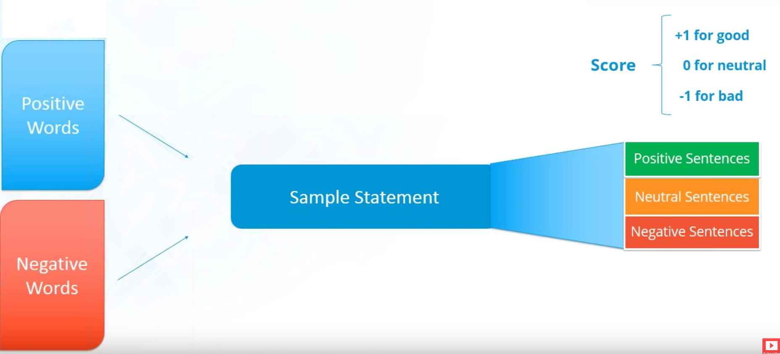
How Does it Works?

Slide 11
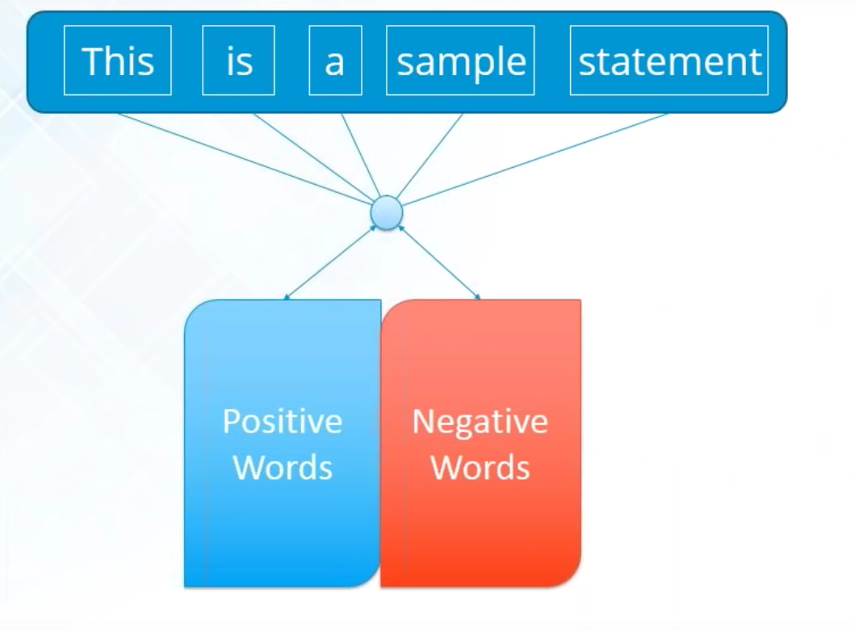
How Does the Algorithm Works?

Slide 12
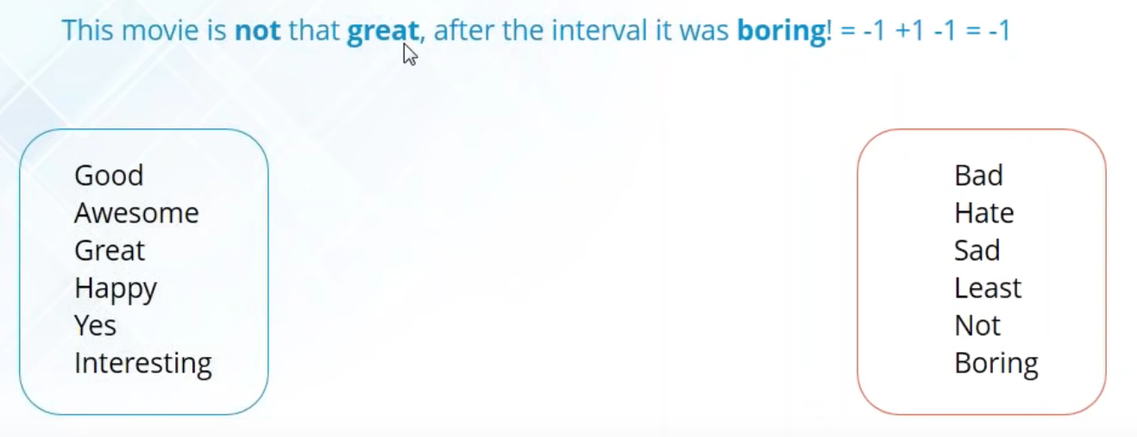
Sentimental Analysis Example

Slide 13

Sentimental Analysis Example

Slide 14
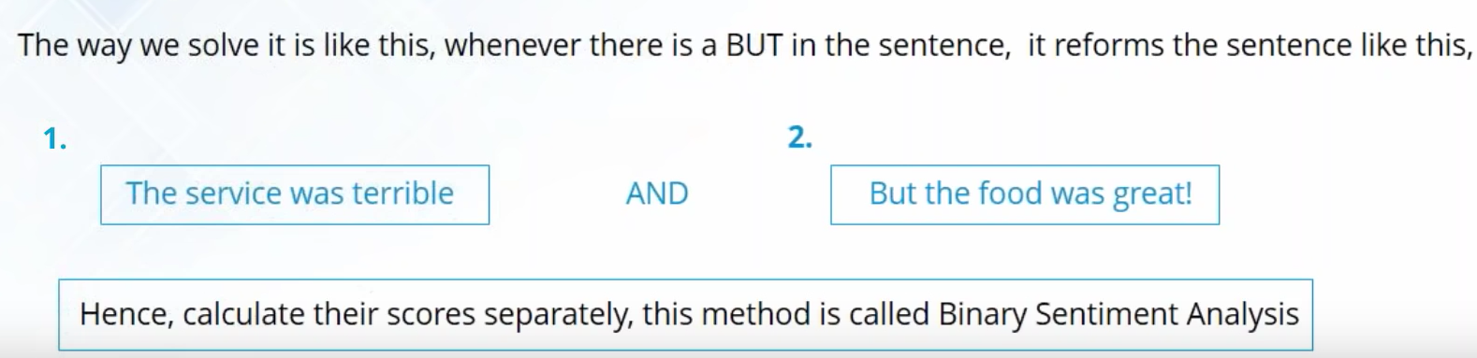
Sentimental Analysis Example

Slide 15


Slide 16
Extraction of Tweets
1. Extraction of Tweets
(i) Create twitter application
(ii) twitteR - Provides an interface to the Twitter web API
(iii) ROAuth - R Interface For OAuth
(iv) Create twitter authenticated credential object(using key from step (ii) and
cacert.pem certificate): It is done using consumer key, consumer secret, access
token, access secret.
(v) During authentication, we are redirected to a URL automatically where we
click on Authorize app as shown in the image below and enter the unique
7-digit number to get linked to the account from which feeds are being taken.

Slide 17
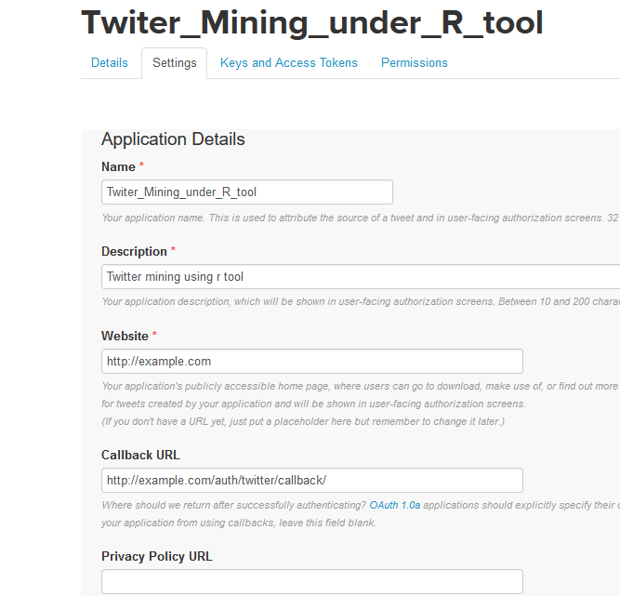
Creation of Application

Slide 18
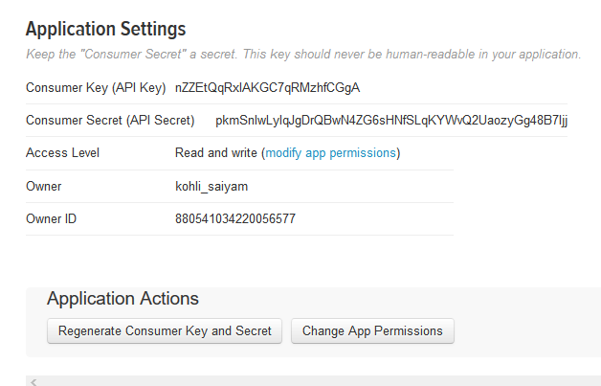
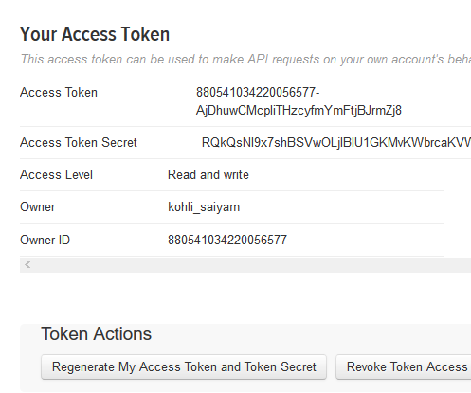
Getting Tokens and keys for Authentication

Slide 19
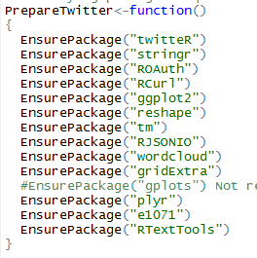
Packages needed to be Installed

Slide 20
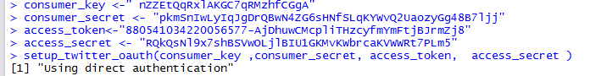
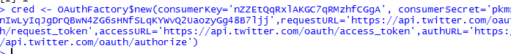
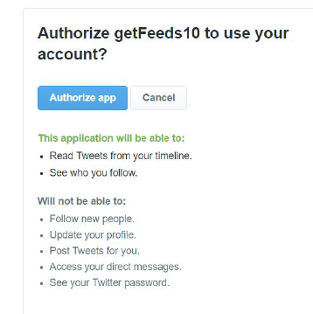
Setting Connection in R with Twitter

Slide 21

Case study: FC Barcelona vs Real Madrid

Slide 22
Cleaning Tweets DATA
The tweets are cleaned in R by removing:
● Extra punctuation
● Stop words (Most commonly used words in a language like the, is, at, which, and on.)
● Redundant Blank spaces
● Emoticons
● URLS

Slide 23
CODE IN R FOR CLEANING
sentence = gsub('[[:punct:]]',' ',sentence)
sentence = gsub('[[:cntrl:]]','',sentence)
sentence = gsub('\\d+','',sentence)
sentence = gsub('\n','',sentence)
sentence = tolower(sentence)
word.list = str_split(sentence, '\\s+')
words = unlist(word.list)

Slide 24
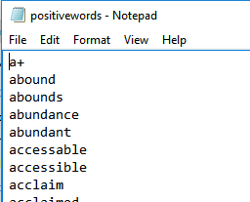
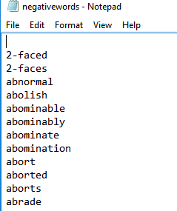
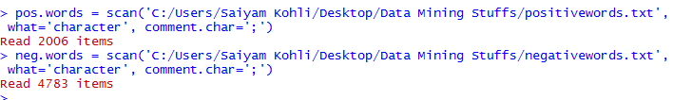
LOADING POSITIVE WORDS AND NEGATIVE WORDS IN DATABASE

Slide 25
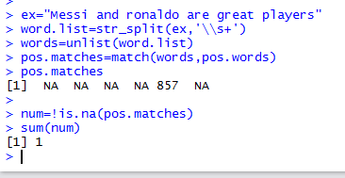
How sentimental analysis works.

Slide 26
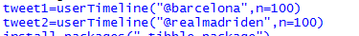
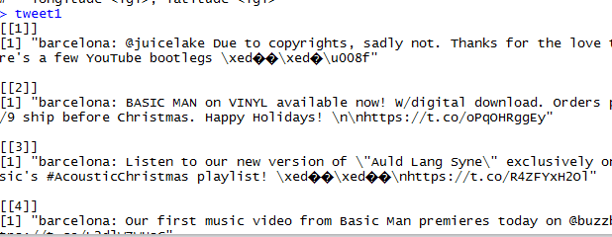
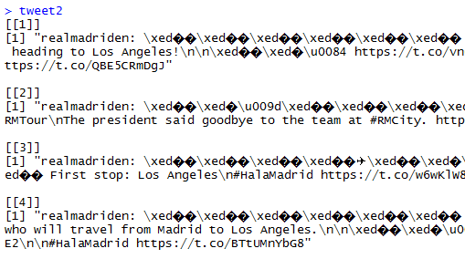
IMPORTING TWEETS FOR BARCELONA AND MADRID

Slide 27
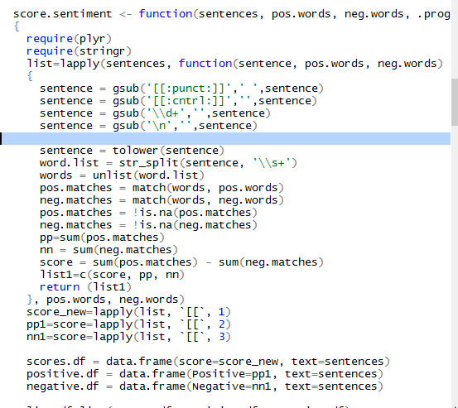
CLEANING OF DATA

Slide 28
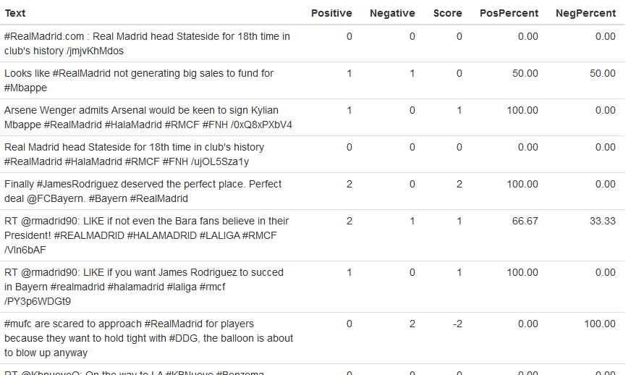
SENTIMENTAL ANALYSIS FOR REAL MADRID

Slide 29
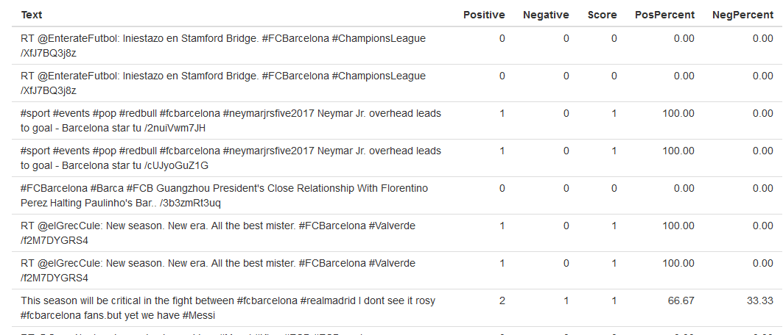
SENTIMENTAL ANALYSIS FOR FC BARCELONA

Slide 30
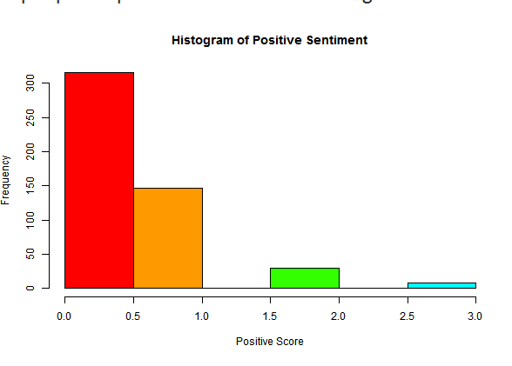
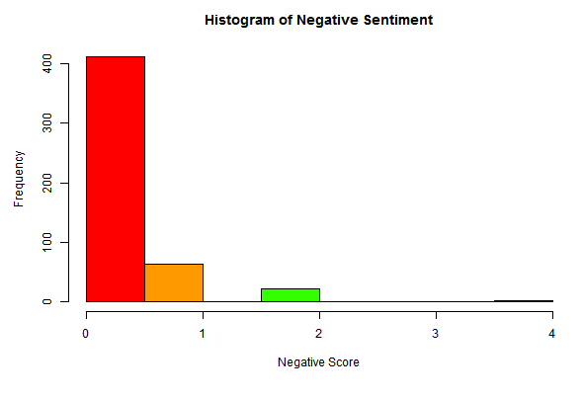
HISTOGRAM FOR FC BARCELONA SENTIMENTS

Slide 31
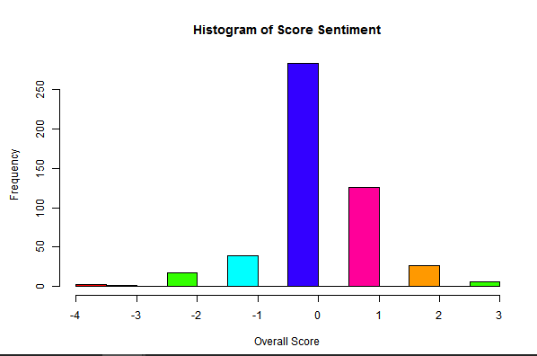
OVERALL SCORE SENTIMENT FOR FC BARCELONA

Slide 32
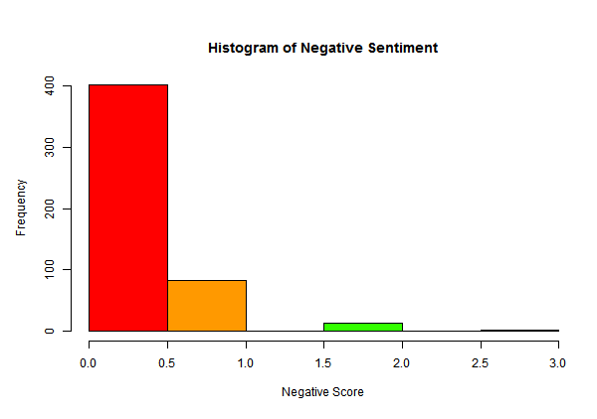
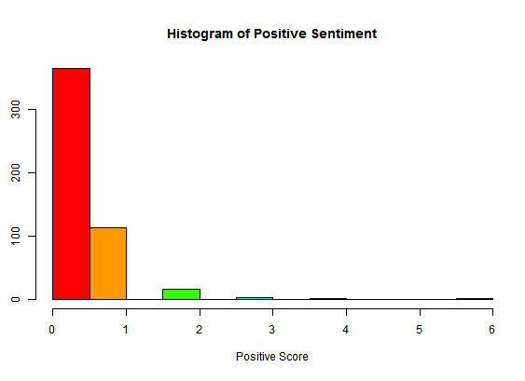
HISTOGRAM FOR REAL MADRID

Slide 33
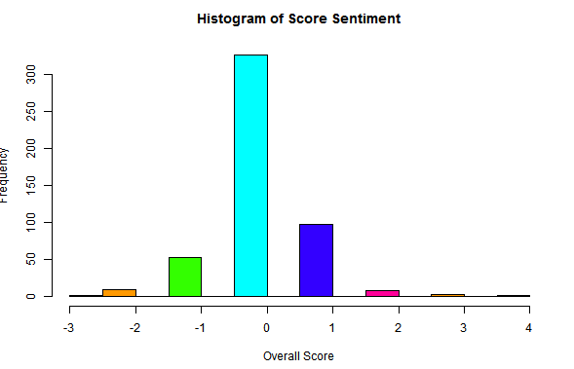
OVERALL SCORE SENTIMENT FOR REAL MADRID

Slide 34
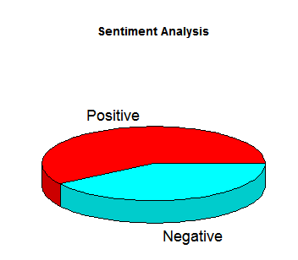
PIE CHART FOR REAL MADRID

Slide 35
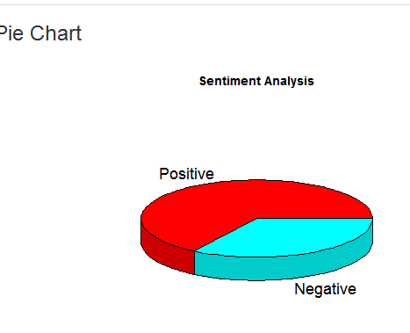

PIECHART FOR FC BARCELONA

Slide 36
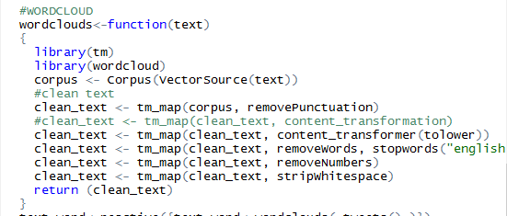
R SCRIPT FOR WORD CLOUD

Slide 37
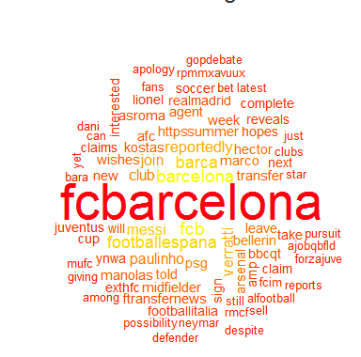
WORD CLOUD FOR FC BARCELONA

Slide 38
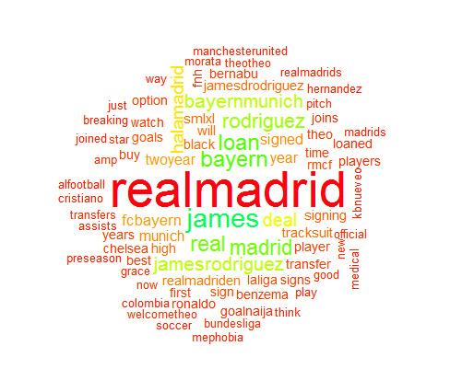
WORD CLOUD FOR REAL MADRID

Slide 39
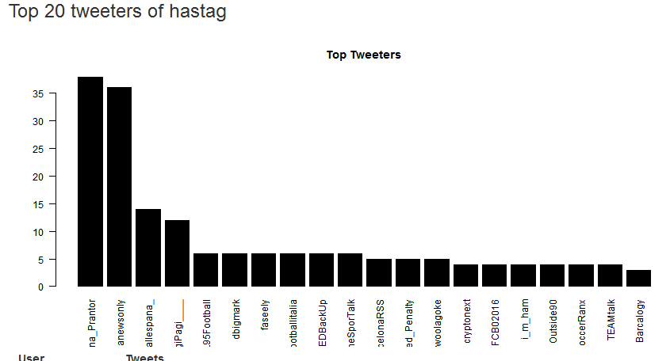
TOP 20 TWITTER HASHTAG FOR FC BARCELONA

Slide 40
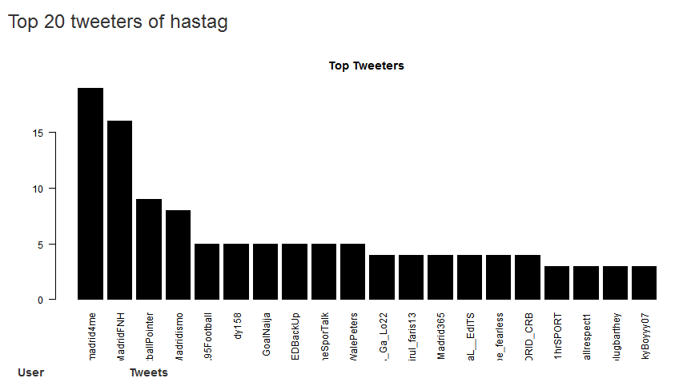
TOP 20 TWITTER HASHTAG FOR REAL MADRID

Slide 41
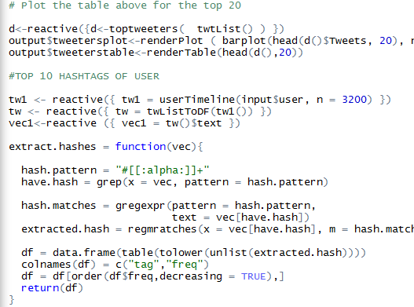
R Script for Top Twitter HashTag

Slide 42
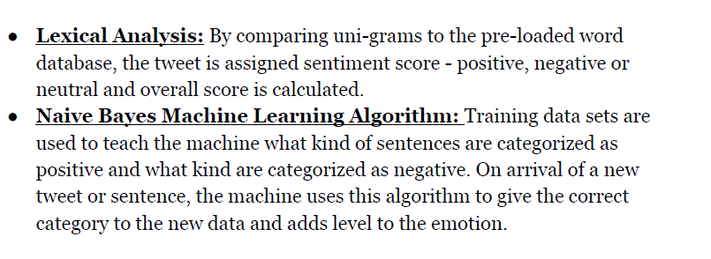
Algorithms Used

Slide 43
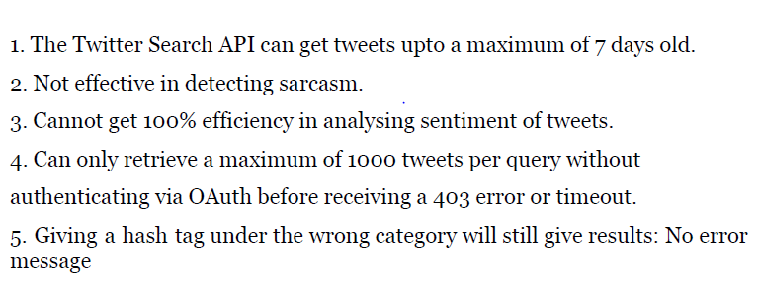
Limitations

Slide 44
THANK YOU!

